Slide 1

Organizational Behavior
(MGT-502)
Lecture-44

Slide 2
Summary of
Lecture-43

Slide 3
High-Performance Organization?
Organization’s mission
Strategies
Goals

Slide 4

Performance Management
1. Planning
Set goals and measures
Establish and communicate
elements and standards
2. Monitoring
Measure performance
Provide feedback
Conduct progress review
Five Key Components
5. Rewarding
Recognize and reward
good performance
3. Developing
Address poor
performance
Improve good
performance
4. Rating
Summarize performance
Assign the rating of
record

Slide 5
The Foundations
Communication- “Open and Honest”
Integrity
Accountability

Slide 6
How can we do it?

Slide 7
Positive consequence
(reinforced by reward)
Repeated
Behavior
Not repeated
Negative consequence
(no reward)

Slide 8
Shifts in Performance Management
NOW
Plan, Focus and Review
Forward looking
Employee initiated and managed
2+ times, ongoing
Results/Outcomes linked to business goals
Learning & competencies integral
PAST
Appraisal
Backward looking
Supervisor driven
Once per year
Tasks (job description)
Minimal personal development

Slide 9
Final Thoughts
“If a group of people is to become a social entity and work (or live) together over time then they must: Trust one another, demonstrate courage, treat each other with fairness, respect, dignity and love, and be honest with one another.”
- Dr. Ian Macdonald

Slide 10
Today’s Topics

Slide 11
Global Organizational Behavior
Challenges and Opportunities

Slide 12
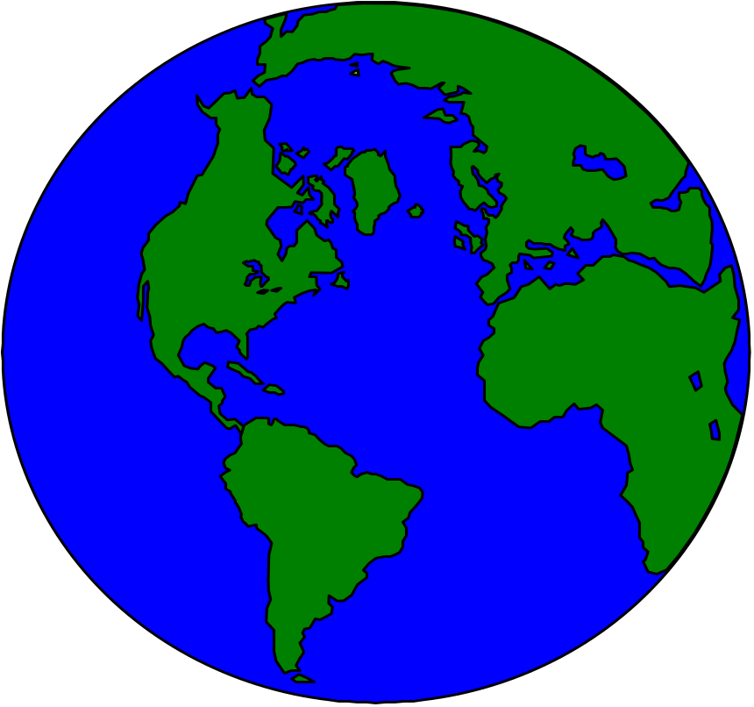


Slide 13
Why Engage in International Business
Expand sales
Acquire resources
  Better components, services, products
  Foreign capital
  Technologies
  information

Slide 14
Why International Business is Growing
Liberal government policies on trade
Rapid improvement of technology
  Transportation is quicker while costs are lower
  Communication enables control from afar
New institutions to support trade:
  Global banking
Consumer demand
Companies learning from each other

Slide 15
How Does Globalization
Affect People at Work?
Multinational employers.
  Multinational corporation (MNC).
    A business firm that has extensive international operations in more than one foreign country.
  MNC characteristics.
    Missions and strategies are worldwide in scope.
    Has a total world view without allegiance to any one national home.
    Has enormous economic power and impact.

Slide 16
How Does Globalization
Affect People at Work?
Multicultural workforces.
  Styles of leadership, motivation, decision making, planning, organizing, and controlling vary from country to country.

Slide 17
How Does Globalization
Affect People at Work?
Ethical behavior across cultures.
  Ethical challenges result from:
    Cultural diversity.
    Variations in governments and legal systems.
  Prominent current issues:
    Corruption and bribery.
    Poor working conditions.
    Child and prison labor.

Slide 18
How Does Globalization
Affect People at Work?
Are management theories universal?
  Answer is “no.”
  Cultural influences should be carefully considered in transferring theories and their applications across cultures.

Slide 19
Why is Globalization Significant for Organizational Behavior?
Outsourcing.
  Contracting out of work rather than accomplishing it with a full-time permanent workforce.
Off shoring.
  Contracting out work to persons in other countries.
Job migration.
  Movement of jobs from one location or country to another.

Slide 20
Why is Globalization Significant to Organizational Behavior?
A global economy.
  Information technology and electronic communications have:
    Promoted a global economy.
    Created Internet business opportunities.
  Transnational movement of products, trends, values, and innovations.
  Multicultural workforces.

Slide 21
Why is Globalization Significant to Organizational Behavior?
Regional economic alliances.
  European Union (EU).
  North American Free Trade Agreement (NAFTA).
  Caribbean Community (CARICOM).
  Asia-Pacific Economic Co-operation Forum (APEC).

Slide 22
Why is Globalization Significant to Organizational Behavior?
Global quality standards.
  ISO designation for quality standards.
  ISO framework for quality assurance worldwide.
  ISO certification is important for doing business and developing a reputation as a “world-class” manufacturer.

Slide 23
Why is Globalization Significant to Organizational Behavior?
Global Managers.
  A global manager is someone who knows how to conduct business across borders.
  The global manager:
    Is often multilingual.
    Thinks with a world view.
    Appreciates diverse beliefs, values, behaviors, and practices.
    Is able to map strategy in light of the above.

Slide 24
Why is Globalization Significant to Organizational Behavior?
Challenges facing global managers.
  Managers’ styles and attitudes may not work well overseas.
  A global mindset is required in order to avoid failure.

Slide 25
Reasons Why Managers Fail in Foreign Assignments
Manager’s spouse cannot adjust to new physical or cultural surroundings
Manager cannot adapt to new physical or cultural surroundings
Family problems
Manager is emotionally immature
Manager cannot cope with foreign duties
Manager is not technically competent
Manager lacks proper motivation for foreign assignment

Slide 26
Global Skills for Global Managers
Global Perspective: Focus on global business
Cultural Responsiveness: Become familiar with many cultures
Appreciate Cultural Synergies: Learn multicultural dynamics
Cultural Adaptability: Live and work effectively in different cultures
Cross-Cultural Communication: Daily cross-cultural interaction
Cross-Cultural Collaboration: Multicultural teamwork
Acquire Broad Foreign Experience: Series of foreign career assignments

Slide 27
Foreign Assignment Cycle
Home Country Experiences
Foreign Country Experiences
1. Selection and
training
“Unrealistic expectations”
2. Arrival and
adjustment
“Culture shock”
Reassignment
4. Returning
home and
adjusting
“Reentry shock”
3. Settling in and
acculturating
“Lack of support”

Slide 28
Factors that Influence the OB in Global Organizations
Customers
Language and communication styles
Attitudes toward time
The workforce
Differences in pay scales
Standards of ethics
Political climate
Variations in foreign exchange rates

Slide 29
Why is Globalization Significant for Organizational Behavior?
Culture.
Language.
Time orientation.
Use of space.
Power distance.
Values and national culture.
Religion.
Uncertainty avoidance.
Long-term/short-term orientation.

Slide 30
Organizational Structure
The functions of an organization are to provide:
  a route and locus of decision making and coordination
  a system for reporting and communications

Slide 31
Organizational Structure
The design of a structure will depend on:
  the stage or degree or internationalization
  the desired way to group people and resources to achieve goals

Slide 32
Locus of Decision Making
Decentralization gives a high degree of autonomy to subsidiaries.
Centralization has control and strategic decision making concentrated at headquarters.

Slide 33

Centralized
Coordinated Decentralization

Slide 34
Coordinated Decentralization
Overall corporate strategy is provided from headquarters.
Subsidiaries are free to implement it within the range agreed on with headquarters.

Slide 35
Decentralized Federation Model
HQ
Subsidiary

Slide 36
The Networked Global Organization Model
HQ
Subsidiary

Slide 37

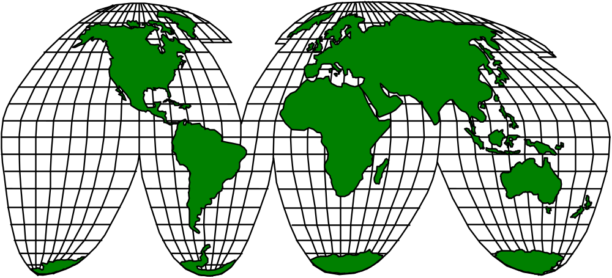
Intranets and Virtual Teams

Slide 38
Cultural Influences on
Organizational Behavior
Organizational
Culture
Economic/
technological
setting
Political/
legal setting
Ethnic
background
Religion
Societal
culture
Customs
Language
Personal
values/ethics
Attitudes
Assumptions
Expectations
Organizational
Behavior

Slide 39

Ethics at Work
Key Issue:
Where does one draw the line
when trying to be flexible and
adaptable in a foreign
country and culture?

Slide 40
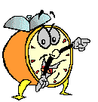
Let’s stop it here

Slide 41
Summary

Slide 42
Next….

Slide 43
Organizational Behavior
(MGT-502)
Lecture-44

